Slide 1
User authentication with Xamarin and ASP.NET MVC
2017.09.16

Slide 2



Platinum Sponsors

Slide 3



Gold Sponsors

Slide 4
Silver Sponsors

Slide 5
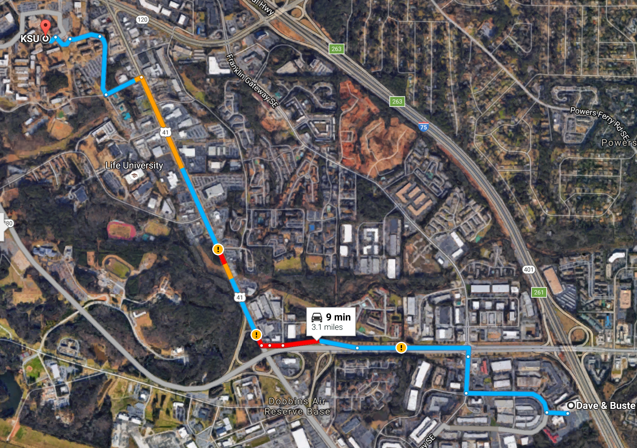

After Party
Dave & Busters
2215 D&B Drive Southeast Marietta, GA
Sponsored By:

Slide 6
Me:
Bradley Dean
Lead Consultant at Magenic
bradd@magenic.com
http://truegeek.com/
Today’s code:
https://github.com/TrueGeek/ATLCodeCamp2017

Slide 7
What We’re Building
The Server
ASP.NET MVC Web App
Web API Controllers
ASP.NET Identity
Token Authentication
The Client
Xamarin.Forms
iOS / Android
PCL for shared code

Slide 8



What We’re Building: Bring Me Soup!
Requirements
User logon
Token is persisted
Authenticated APIs
Out Of Scope
Mobile notifications
Decent UX
User One Needs Soup!

Slide 9
What We’re Building: Bring Me Soup!
Tables Needed
Endpoints Needed
Requests
Id
RequestedByUserId
RequestedOn
FullfilledByUserId
FullfilledOn
Users
UserId
UserType (Sick / Caretaker)
SickCode
/Token
POST
/Requests
GET
POST
/FullfillRequest
POST
/Register
POST

Slide 10
Demo

Slide 11
Token Authentication
credentials
CLIENT
credentials
TOKEN SERVER
token
token
RESOURCE
SERVER
resource

Slide 12
Token Authentication
Identity Server
https://identityserver.io/
OpenIddict
https://github.com/openiddict/openiddict-core
Built into .Net Framework API projects
NOT ported to .Net core
Not included when you select MVC projects

Slide 13
Back To Demo

Slide 14
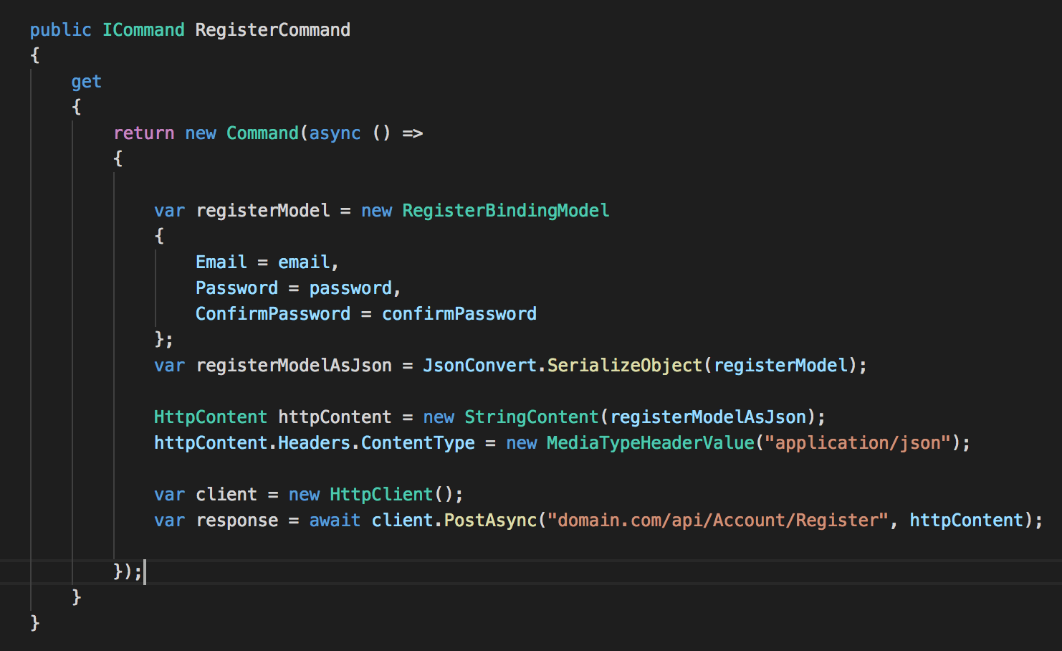
Register User Account On Mobile

Slide 15
Register User Account On Mobile

Slide 16
Back To Demo

Slide 17
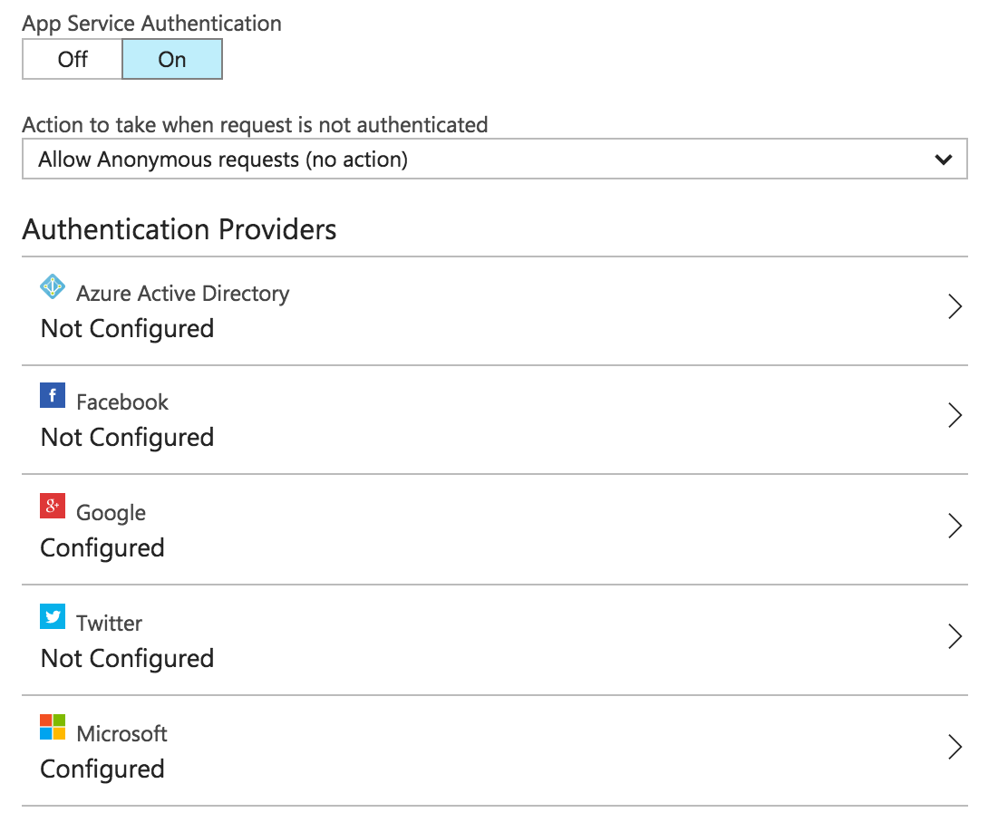
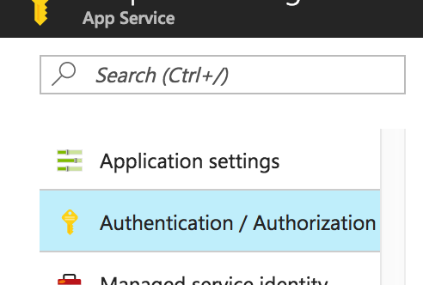
Azure App Service Authentication
Code-less App Authentication
Available in Azure with App Service plans
Provides OAuth Authentication with:
Azure AD
Facebook
Google
Twitter
Microsoft
Does not allow username / password

Slide 18
Facebook Logon
Enable Facebook logon on ASP.NET MVC site like normal
Create account with Facebook
Enable in statup.auth.cs
https://docs.microsoft.com/en-us/aspnet/mvc/overview/security/create-an-aspnet-mvc-5-app-with-facebook-and-google-oauth2-and-openid-sign-on#creating-the-app-in-facebook-and-connecting-the-app-to-the-project
You MUST use Facebook client SDK!
https://components.xamarin.com/view/facebookios
https://components.xamarin.com/view/facebookandroid
Validate Facebook token

Slide 19
Facebook Logon
fb credentials
user info
fb token
fb token
OUR TOKEN SERVER
fb token
our token

Slide 20
Facebook Logon
Extend OAuthAuthorizationServerProvider to accept grant_type of “facebook” at /token
Check for this grant_type and re-send the token to Facebook
Look for a user in dbo.AspnetUserLogins where ProviderKey == the id returned by Facebook. Generate a token for that user.

